Slide 1



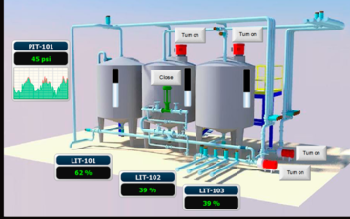
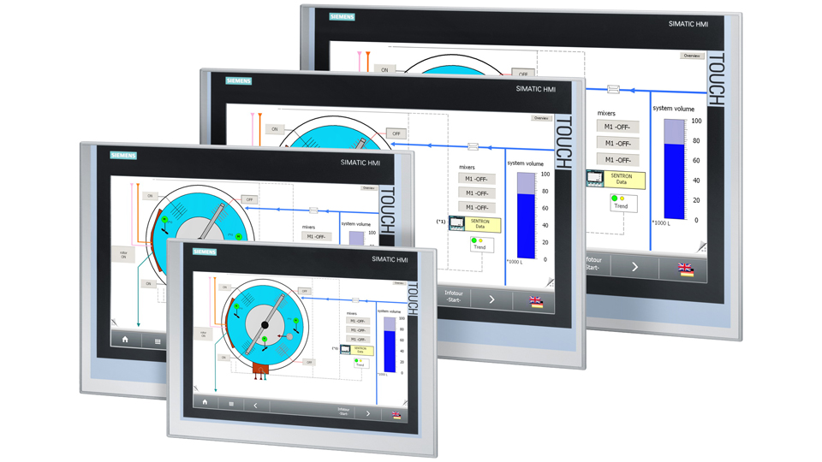
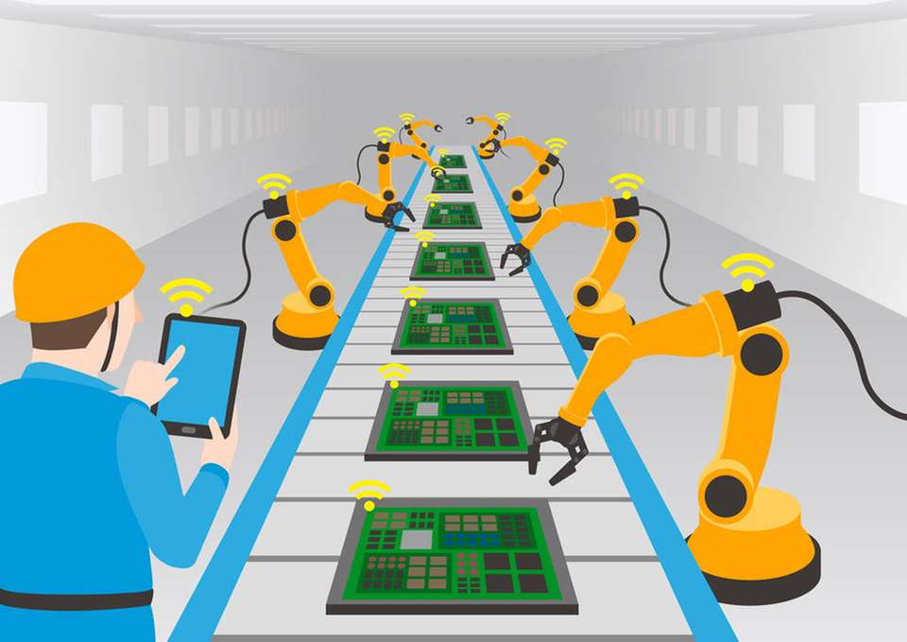
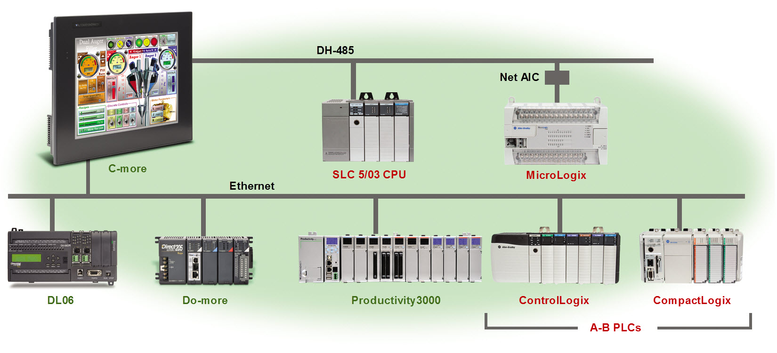
SMART HMI
Mentor : HEL Chanthan
User in the car
Control water and weather
Controller Machinery
Controller PLC
Application
INTRODUCTION
Pump stations
Storm flow monitoring
Storm flow reservoir
Wastewater treatment plants
Control of aerators in sewage plants
Energy optimization
Water supply plants and raw water sources
Raw water borings
Pressure control
HMI Display unit, provides fast and direct system supervision and pump control via the intuitive touch screen navigation.
This allows the end-user to do on-site evaluation and correction of the attached Mµ Connect or connect devices.
Team
Name BIN Chanthy
Group I4
Department GTR

